Slide 1
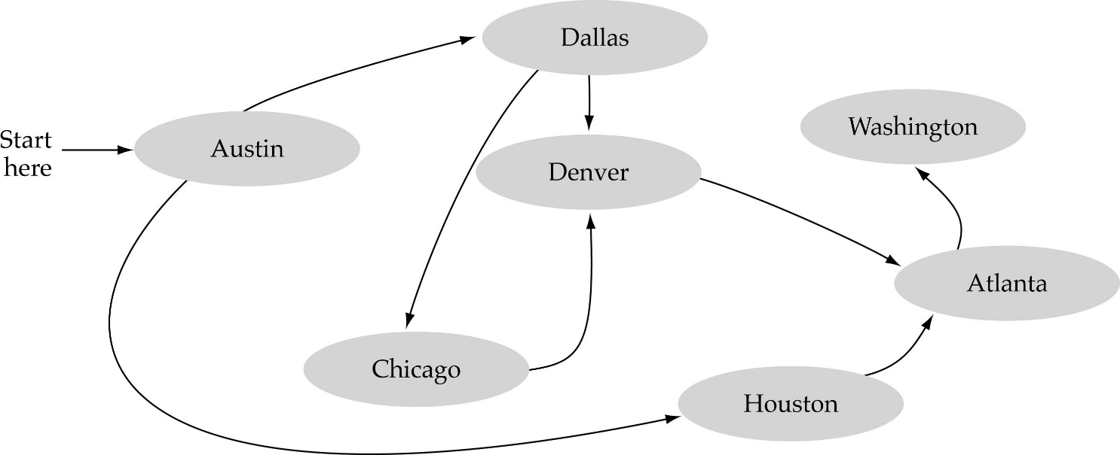
What is a graph?
A data structure that consists of a set of nodes (vertices) and a set of edges between the vertices.
The set of edges describes relationships among the vertices.
1
2
3
4

Slide 2
Terminology
Definition:
  A set of points that are joined by lines
Graphs also represent the relationships among data items
G = { V , E }
  a graph is a set of vertices and edges
A subgraph consists of a subset of a graph’s vertices and a subset of its edges

Slide 3
Formally
a graph G is defined as follows:
        G = (V,E)
where
  V(G) is a finite, nonempty set of vertices
  E(G) is a set of edges
    written as pairs of vertices

Slide 4
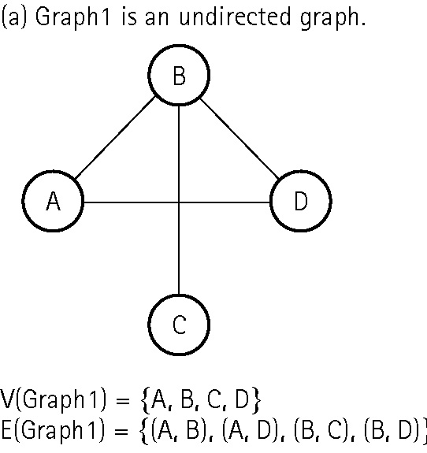
An undirected graph
A graph in which the edges have no direction
The order of vertices in E
is not important for
undirected graphs!!

Slide 5
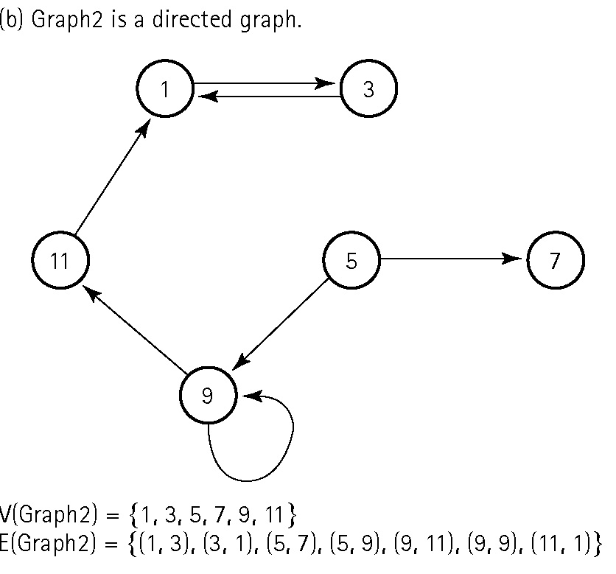
A directed graph
A graph in which each edge is directed from one vertex to another (or the same) vertex
The order of vertices in E
is important for
directed graphs!!

Slide 6
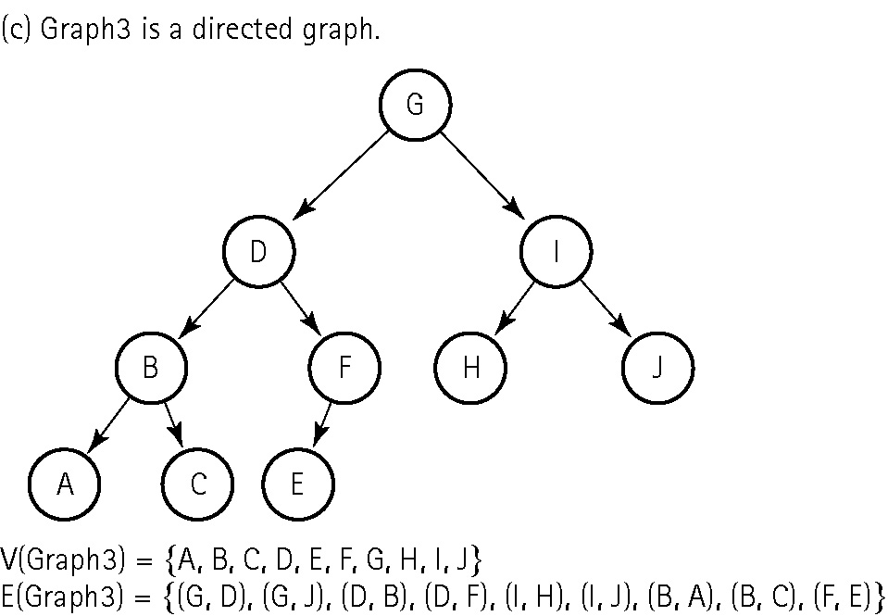
A directed graph
Trees are special cases of graphs!

Slide 7
Terminology
Undirected graphs: edges do not indicate a direction
Directed graph, or digraph: each edge has a direction

Slide 8
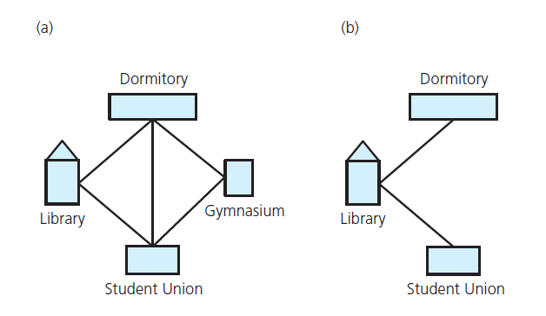
Terminology
(a) A campus map as a graph;
(b) a subgraph

Slide 9
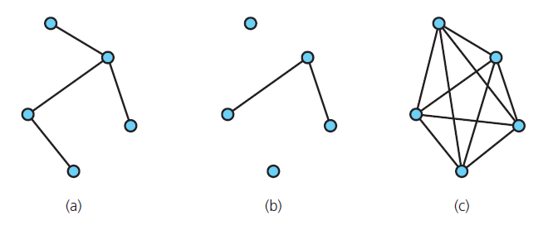
Terminology
Graphs that are (a) connected;
(b) disconnected; and (c) complete

Slide 10
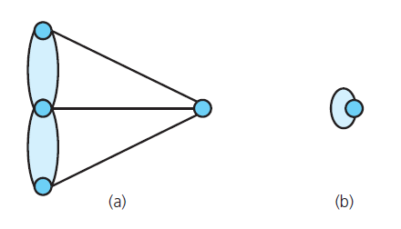
Terminology
(a) A multigraph is not a simple graph;
(b) a self edge is not allowed in a simple graph

Slide 11
Graph terminology
Path: A sequence of vertices that connects two nodes in a graph
The length of a path is the number of edges in the path.
1
2
e.g., a path from 1 to 4
<1, 2, 3, 4>
3
4

Slide 12
Terminology
Simple path: passes through vertex only once
Cycle: a path that begins and ends at same vertex
Simple cycle: cycle that does not pass through other vertices more than once
Connected graph: each pair of distinct vertices has a path between them

Slide 13
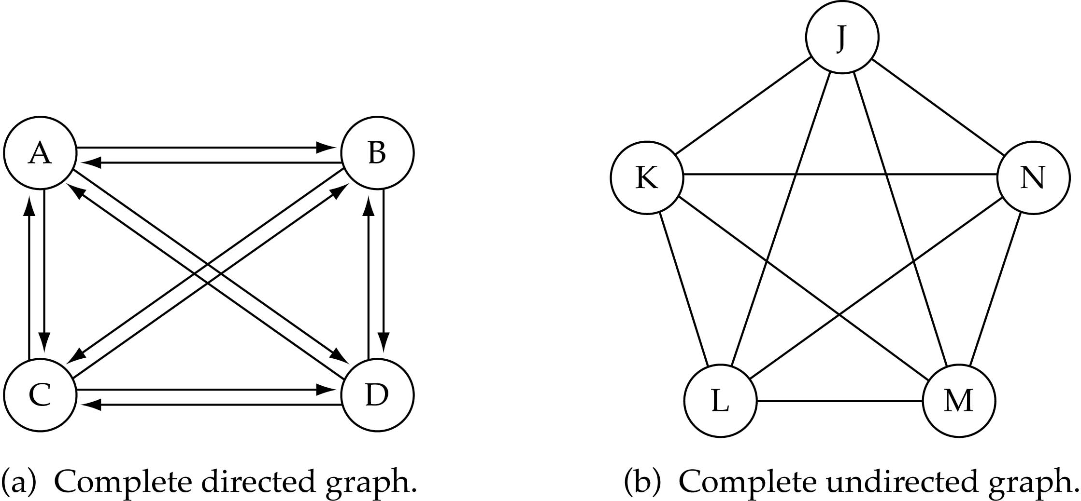
Graph terminology
Complete graph: A graph in which every vertex is directly connected to every other vertex

Slide 14
Terminology
Complete graph: each pair of distinct vertices has an edge between them
Graph cannot have duplicate edges between vertices
  Multigraph: does allow multiple edges
When labels represent numeric values, graph is called a weighted graph

Slide 15
Graph terminology (cont.)
What is the number of edges E in a complete undirected graph with V vertices?
E=V* (V-1) / 2
or O(V²)

Slide 16
Graph terminology (cont.)
What is the number of edges E in a complete directed graph with V vertices?
E=V * (V-1)
or O(V²)

Slide 17
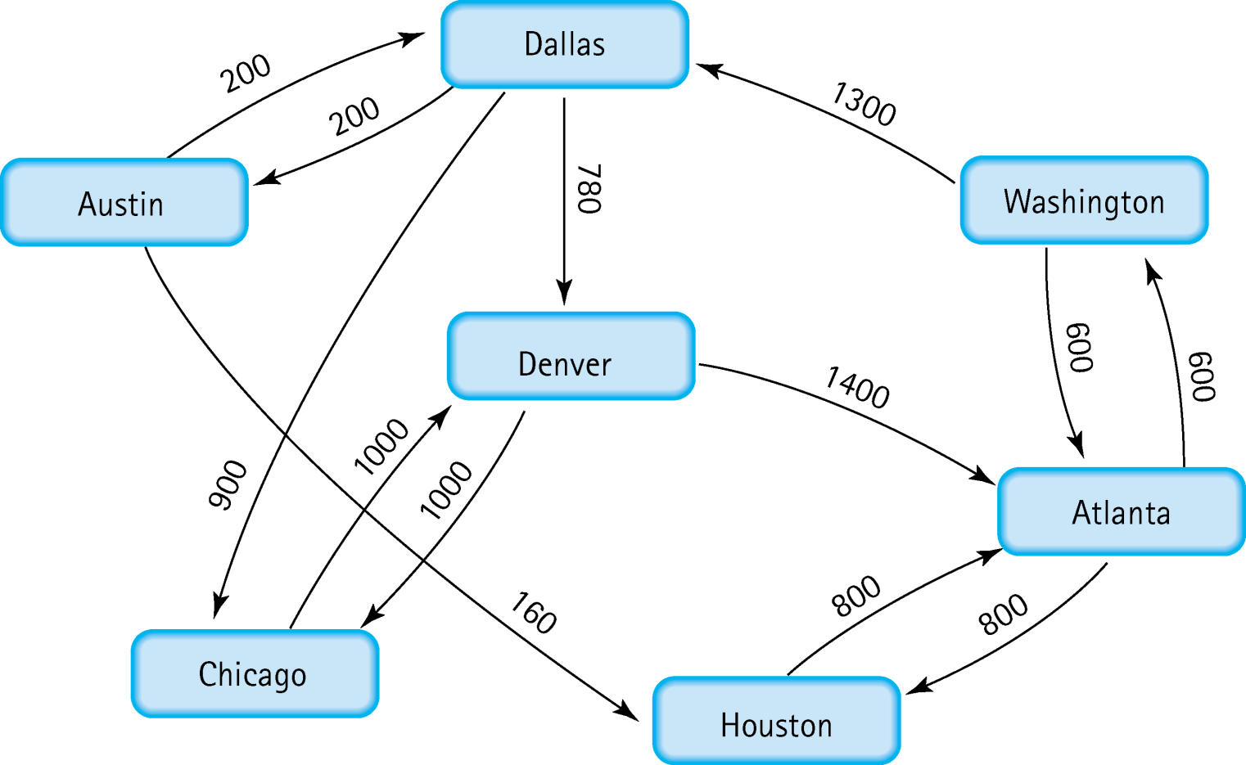
A weighted graph
Weighted graph: A graph in which each edge carries a value

Slide 18
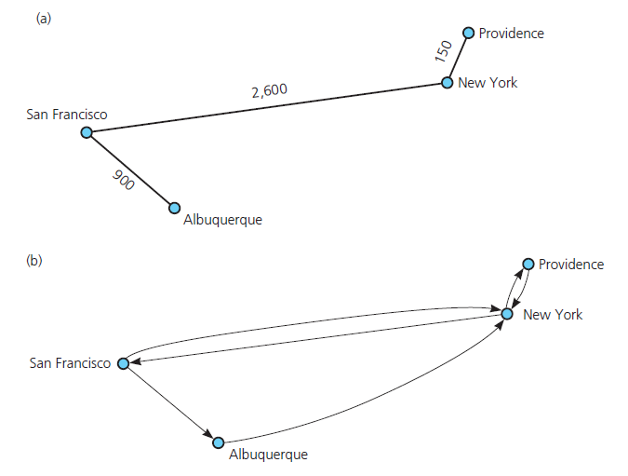
Terminology
(a) a weighted graph; (b) a directed graph

Slide 19
Graphs as ADTs
ADT graph operations
  Test whether graph is empty.
  Get number of vertices in a graph.
  Get number of edges in a graph.
  See whether edge exists between two given vertices.
  Insert vertex in graph whose vertices have distinct values that differ from new vertex’s value.
  Insert edge between two given vertices in graph.

Slide 20
Graphs as ADTs
ADT graph operations, ctd.
  Remove specified vertex from graph and any edges between the vertex and other vertices.
  Remove edge between two vertices in graph.
  Retrieve from graph vertex that contains given value.
View interface for undirected, connected graphs, Listing 20-1

Slide 21
Array-Based Implementation
Use a 1D array to represent the vertices
Use a 2D array (i.e., adjacency matrix) to represent the edges
Adjacency Matrix:
  for a graph with N nodes,
    an N by N table that shows the existence (and weights) of all edges in the graph

Slide 22
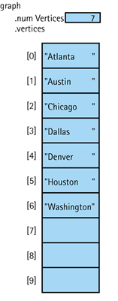
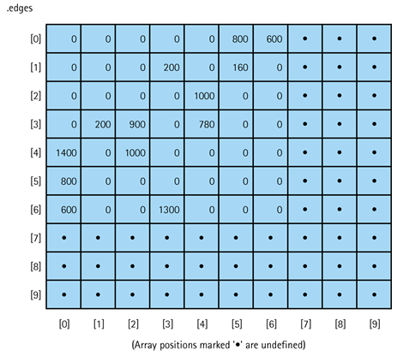

Adjacency Matrix for Flight Connections
from node x ?
to node x ?

Slide 23

Array-Based Implementation (cont.)
Memory required
  O(V+V²)=O(V²)
Preferred when
  The graph is dense: E = O(V²)
Advantage
  Can quickly determine if there is an edge between two vertices
Disadvantage
  Consumes significant memory for sparse large graphs

Slide 24
Linked Implementation
Use a 1D array to represent the vertices
Use a list for each vertex v which contains the vertices which are adjacent from v (i.e., adjacency list)
Adjacency List:
  A linked list that identifies all the vertices to which a particular vertex is connected;
    each vertex has its own adjacency list

Slide 25
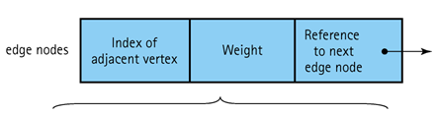
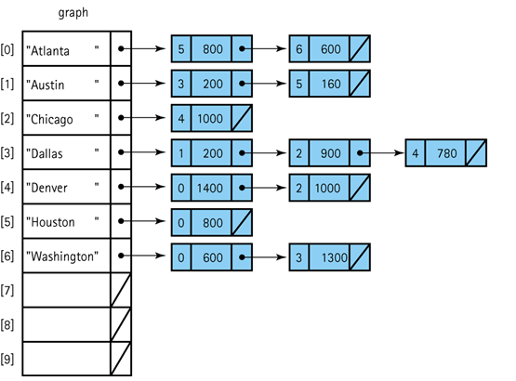
Adjacency List Representation of Graphs
from node x ?
to node x ?

Slide 26
Link-List-based Implementation (cont.)
Memory required
  O(V + E)
Preferred when
  for sparse graphs: E = O(V)
Disadvantage
  No quick way to determine the
  vertices adjacent to a given vertex
Advantage
  Can quickly determine the vertices adjacent from a given vertex
O(V) for sparse graphs since E=O(V)
O(V²) for dense graphs since E=O(V²)

Slide 27
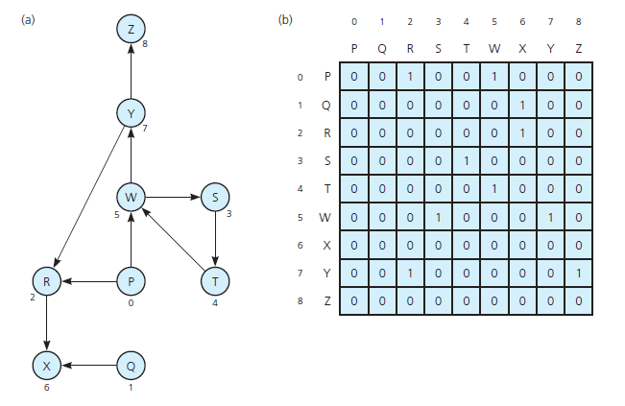
Implementing Graphs
(a) A directed graph and
(b) its adjacency matrix

Slide 28
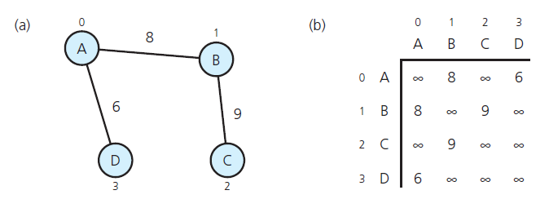
Implementing Graphs
(a) A weighted undirected graph and
(b) its adjacency matrix

Slide 29
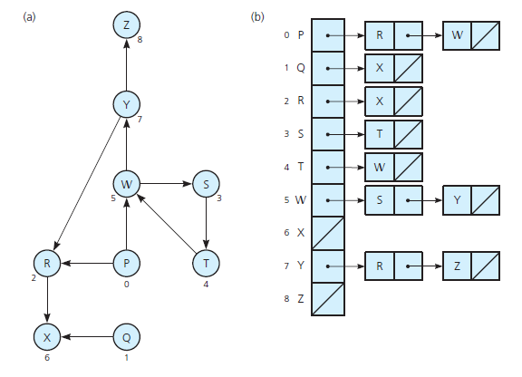
Implementing Graphs
(a) A directed graph and
(b) its adjacency list

Slide 30
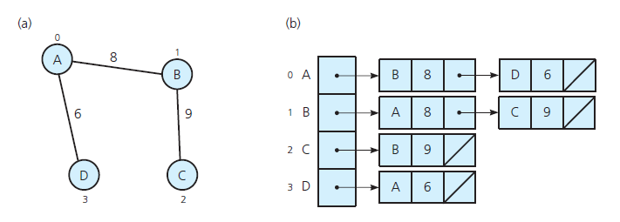
Implementing Graphs
(a) A weighted undirected graph and
(b) its adjacency list

Slide 31
Graph Traversals
Visits all of the vertices that it can reach
  Happens if graph is connected
Connected component is subset of vertices visited during traversal that begins at given vertex

Slide 32

Graph searching
Problem: find if there is a path between two vertices of the graph
  e.g., Austin and Washington
Methods: Depth-First-Search (DFS) or Breadth-First-Search (BFS)

Slide 33
Depth-First-Search (DFS)
Main idea:
  Travel as far as you can down a path
  Back up as little as possible when you reach a "dead end“
    i.e., next vertex has been "marked" or there is no next vertex
startVertex endVertex

Slide 34
Graph Algorithms
Depth-first search
  Visit all the nodes in a branch to its deepest point before moving up
Breadth-first search
  Visit all the nodes on one level before going to the next level
Single-source shortest-path
  Determines the shortest path from a designated starting node to every other node in the graph

